Slide 1

Influencer Partnership Management System
Prepared by:-
Zoe caprice Christopherson
Juhee Makwana
Nikkitha Doppalapudi
Chaitanya Nimmagadda
Sri Sai Praneetha Ravipati
BUAN 6320.501 - Database Foundations for Business Analytics - F24

Slide 2

Introduction
This project focuses on designing a database system to manage partnerships between brands and influencers. It streamlines data management, tracks performance metrics, and enhances collaboration efficiency.

Slide 3

Project Scope
• Entities:
Influencers, Brands, Products, Contracts, Performance Metrics, Content Creation.
• Capabilities:
- Managing contracts, content, and metrics.
- Linking influencers, brands, and products.

Slide 4
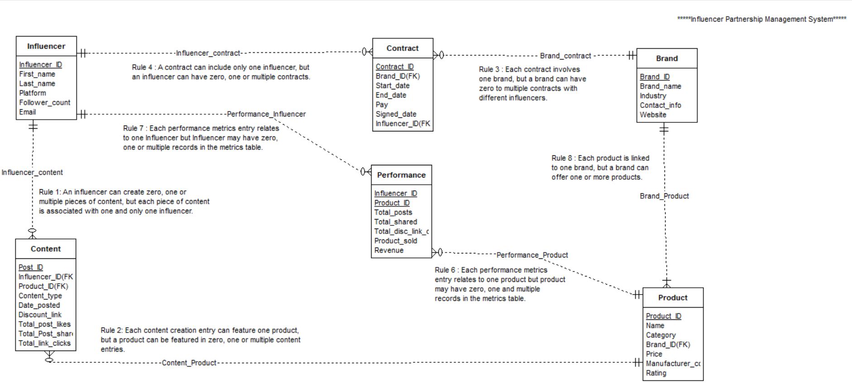
Entity-Relationship Diagram (ERD)

Slide 5

Key Entities and Attributes
1. Influencer: InfluencerID (PK), Name, Platform, Follower_count, Email.
2. Brand: Brand_ID (PK), Name, Industry, Contact_Info, Website.
3. Product: ProductID (PK), Name, Category, Price, Brand_ID (FK).
4. Contract: ContractID (PK), InfluencerID (FK), Brand_ID (FK), Dates, Pay.
5. Performance Metrics: InfluencerID (FK), ProductID (FK), Posts, Revenue.

Slide 6

Assumptions and Constraints
Assumptions:
• Influencers can post unlimited content per contract but only one post per product daily.
• Brands can engage multiple influencers.
• Metrics are periodically updated for performance analysis.
• Metrics will only be collected on content posted between the contract start and end dates for each partnership.
Constraints:
• Primary and Foreign key relationships are strictly enforced.
• No many-to-many relationships in the schema.

Slide 7

SQL Features
• Triggers: Automated updates to performance metrics upon new content creation.
• Functions: Calculated total revenue and post engagement.
• Sequences: Automatically generated unique IDs for contracts, brands, products and posts.

Slide 8
Sequences and Triggers
CREATE SEQUENCES--create sequence influencer_id_seq
CREATE SEQUENCE influencer_id_seq
INCREMENT BY 1
START WITH 101
NO MAXVALUE
MINVALUE 101
NO CYCLE;
create trigger functions--create trigger function trg_influencer
CREATE OR REPLACE FUNCTION trg_influencer() RETURNS TRIGGER AS $$
BEGIN
IF NEW.influencer_id IS NULL THEN
NEW.influencer_id := nextval('influencer_id_seq');
END IF;
RETURN NEW;
END;
$$ LANGUAGE plpgsql;
create triggers--create trigger TRG_influencer
CREATE TRIGGER TRG_influencer
BEFORE INSERT OR UPDATE ON influencer
FOR EACH ROW
EXECUTE FUNCTION trg_influencer();

Slide 9
Advanced Queries with Outputs
Classify each influencer by type (nano, micro, macro, or celebrity) based on their follower count.
SELECT
i.influencer_id,
i.first_name,
i.last_name,
CASE
WHEN follower_count >= 190000 THEN 'Celebrity'
WHEN follower_count >= 100000 THEN 'Macro'
WHEN follower_count >= 10000 THEN 'Micro'
ELSE 'Nano'
END AS influencer_type
FROM
influencer i ;

Slide 10
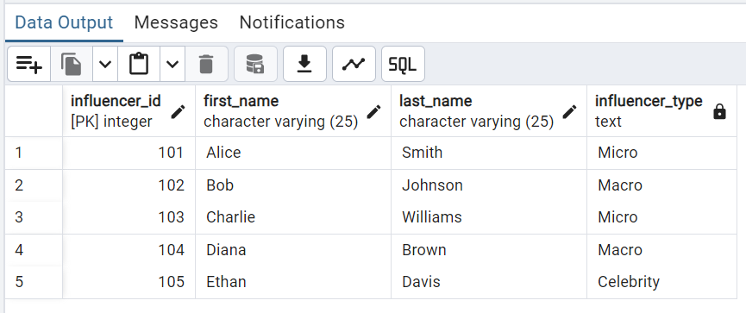
Output

Slide 11
Advanced Queries with Outputs
Identify the Top 3 Most Profitable Products per Brand based on total revenue.
SELECT
b.brand_name,
p.product_name,
SUM(pm.revenue) AS total_revenue
FROM product p
JOIN performance_metrics pm ON p.product_id = pm.product_id
JOIN brand b ON p.brand_id = b.brand_id
GROUP BY b.brand_name, p.product_name
HAVING SUM(pm.revenue) > 0
ORDER BY b.brand_name, total_revenue DESC
LIMIT 3;

Slide 12
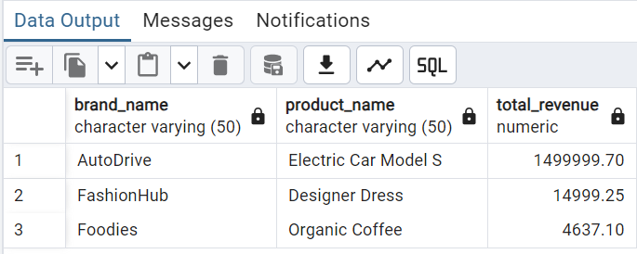
Output

Slide 13

Challenges
• Resolving complex relationships between entities.
• Optimizing query performance for large datasets.
• Implementing effective triggers and functions.

Slide 14
Conclusion
• Successfully developed a scalable database for managing influencer-brand partnerships.
• Streamlined tracking of contracts, content, and performance metrics.
• Prepared the system for future analytics integration.

Slide 15
Thank You

